Slide 1
Part One
The Forms of Software
Documentation chapter2: Writing to Teach- Tutorials chapter3: writing to guide-Procedures chapter4: writing to support- References

Slide 2
Chapter 3
Writing to Guide- Procedures

Slide 3
Guidance Information, also known as step-by- step instruction or procedures, makes up the heart of all task oriented documentation system. Guidance means that the user forfeit a certain amount of control to the manual in order to perform a discrete task, then he or she will resumes control again.
Procedures consist of how-to-do-it explanations, but also require how-it-works and why-it-works overviews. Our job is to balance these elements to meet user informational needs and to make them efficient and effective in their workplace

Slide 4
Information you need to provide in an effective procedures:
- Introduction emphasize creativity and user control of the program.
- Screen shows the user result of actions.
- Tips help the user find ways to use the program efficiently.
- Tables help the user decide what options to exercise for this step.
- Elaboration tells the result of actions and tells the user where to get more information.

Slide 5
Tips- when writing procedures
- Give readers the essential information - information that will help them complete the procedure - first.
- Limit the use of screen captures.
- Make the steps as brief as possible.
- Write in present tense.
- Keep procedures as short as possible. If a procedure becomes extremely long, see whether you can logically break it up into two shorter procedures.
- Reduce the number of decisions a reader has to make. If necessary, move some decision points outside the process steps or redesign the software interface for more consistency across platforms.
- State conditionals clearly at the beginning of sentences or paragraphs, so that readers can skip text that isn't relevant to them.

Slide 6
Guidelines:
1- Relate the Task to Meaningful Workplace
Activities: a procedure is a step by step series of commands for accomplishing a meaningful operation with a software program.
But what makes it meaningful does not reside in the operation itself.
When the user do install the software (procedure) they do this not for the sake of installation, but to use the program to do other workplace actions.

Slide 7
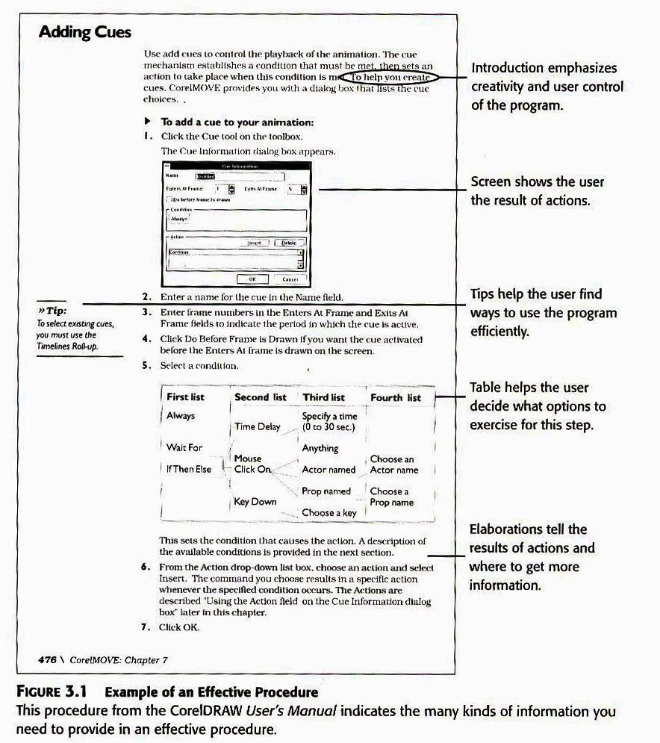
Example of Effective Procedure

Slide 8
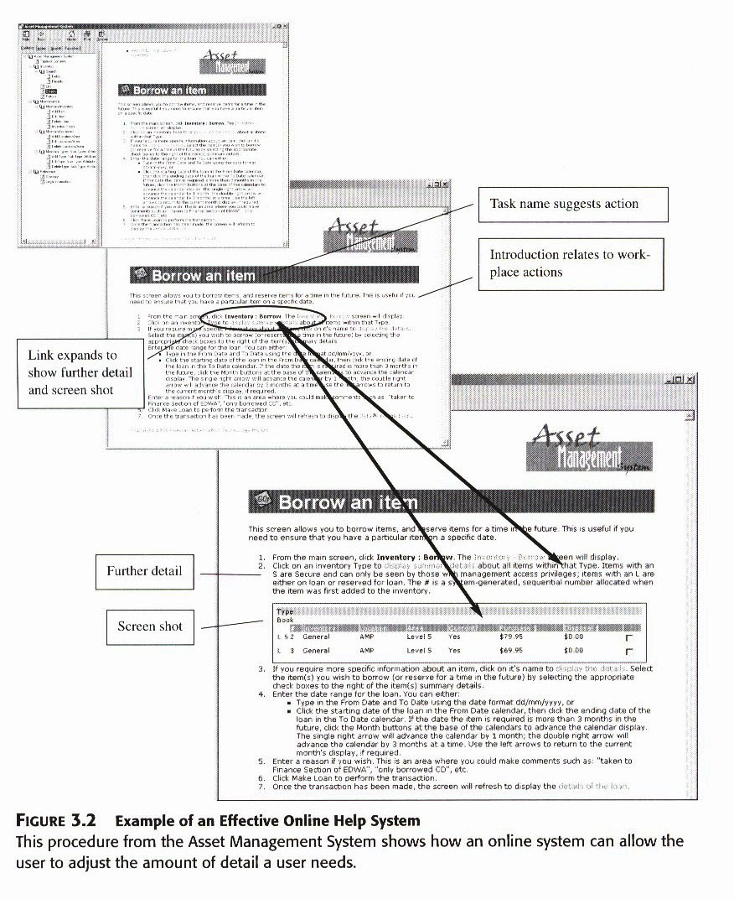
Example of effective online help system

Slide 9
2- Determine how Much Information Your User
Needs: depending on the task difficulty and the user experience the detail of procedure will varies.
A rich procedure needs more visuals, more explanations, more options, describe more results.
A sparse procedure on the other hand require only the repeating of the steps in the task description.

Slide 10
The step with a rich procedure will contain the following explanations:
- What happens when user takes the action
“ you will see… the program prompts you..”
- Suggested response to the program state “ we suggest that.”
- Screens showing where to point the mouse.
- Cautions and warnings.
- Tips for efficient use.
- Tables showing options and choices.
- References to other sections of the manual.

Slide 11
3- Choose the Appropriate Instructional
Format:
- Standard Format, which contains steps, notes, screen shots, and other elements left justified in one or two columns in a sequential order from first to last.
Advantages of this format are its recognizability, its ease of flow from one page to another, the ability to easily re-number tasks, and the easy to see steps.
Some disadvantages are the space it may require and the potential to be confusing if complex steps need to be mixed with simple steps.

Slide 12
- Prose Format
Puts steps in sentences and paragraph forms making it look and feel more conversational over Standard format's command approach.
Advantages of prose are the relaxed tone, saves space, clarifies simple, basic steps, accommodates experienced users.
Some disadvantages are steps buried in paragraphs, lengthy explanation of individual steps, inability to accommodate graphics, and the lack of support for novice users

Slide 13
-Parallel Format, shows a screen with the fields empty and parallels the field names in the steps that follow. This format is nice for programs with complicated data fields of dialog boxes. Some keys to parallel format are to keep terminology consistent, cue terms to the screen, discuss one screen at a time, use plenty of examples, explain the format to the user.
Advantages of parallel format are the organizational benefits, great for complicated screens and dialog boxes.
Disadvantages are it doesn't present the information in step by step format, it can not be used for all procedures, it may confuse users, it has to fit on one page.

Slide 14
-Embedded Help, is the name for "interactive assistance" found in most programs today. Uses for embedded help are tips for effective use (reminders of keyboard shortcuts or suggested file names), cue cards (brief explanations of buttons and fields), short animated descriptions, and trouble-shooting tips. Different types of embedded help are:
Embedded help can offer the following info:
- Tips for efficient use
- Cue cards brief explanation of buttons and fields.
- Short animated demo.
- Trouble shooting tips.

Slide 15
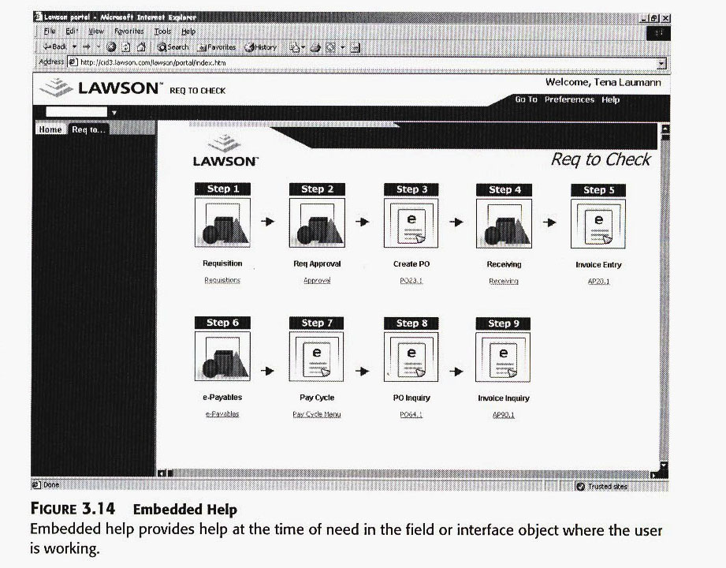
Example of embedded help

Slide 16
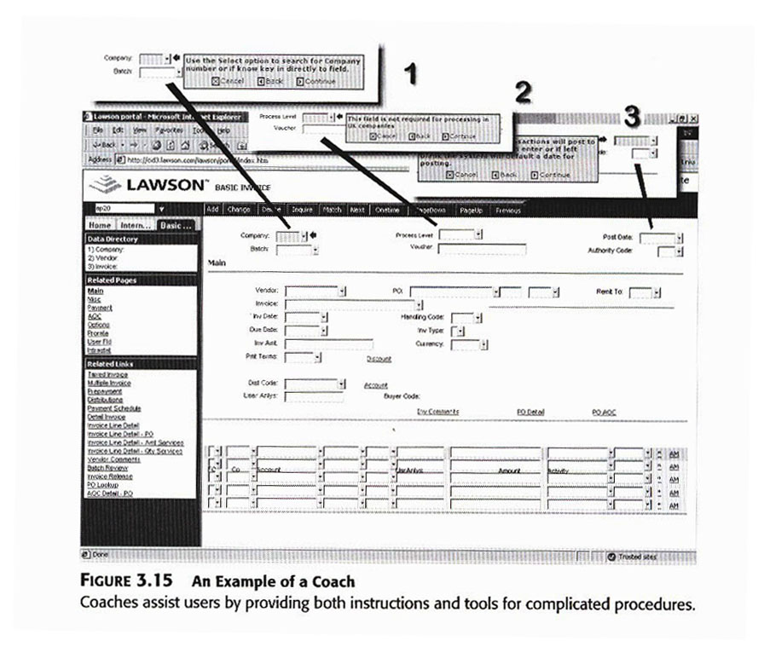
Example of a coach

Slide 17
3- Follow a Rhythm of Exposition, which means a pattern of steps, note, and illustration. Such as:
- first I say what will happen.
- then I give the command for the first action.
- then I say how the program will respond.
- then I tell the next step.
The basic idea of rhythm of expositions lies in the action/response pattern. Computer programs work in the way: take an action, the system respond, and these events get repeated over and over again.

Slide 18
4- Test all Procedures for Accuracy,
Evaluative test, which means that after you finish the procedure, you have an actual user, or prototype of the user, or yourself as a last resort to perform the steps, so get ready to have your eyes opened to all the conditions, alternatives, options, and other details you left out.

Slide 19
What Constitute a Procedure?
-Procedures results directly from your thorough program task list, putting the functions of the program into usable sets of steps that do the user’s work.
-All procedural documentation answers the user’s simple question “ how do you use the program? As such, it functions on the guidance level. The user need to know what key to press, what reports and screen will look like, how to get out of trouble.
-The teaching as we have seen in tutorials try to get the user to remember the lesson after the lesson finishes.
-Procedures and tutorials differ greatly, procedure focus on options the user might take, whereas tutorials focus on only those keys and actions needed to perform a specific task. A procedure expands the user’s focus, a tutorial contracts it.

Slide 20
- Procedures and reference differs also, in guidance (procedures) the documentation define the task its beginnings and endings, you do this for a user to follow unfamiliar steps to perform a task he or she does seldom or for the first time.
In the support level (reference) the user define the task and goes to the documentation to get an essential info needed to perform the task.

Slide 21
What Kind of Info User Need Guidance?
Installation because it varies from system to system user needed guidance, maintaining and repairing systems.
Finally the goal of the procedure should indicate what task it performs; installing printer, retrieving a record.

Slide 22
How Does a Procedure Work? A procedure works, guide the user through a series of tasks to a designated end, because you designed each of its parts to do a specific job. The following discuss how each of those parts contribute to the overall task orientation of the procedure:
-Task Name, use performance oriented language such as “opening a file” or “printing a card”.

Slide 23
- Scenario, it means a small story or narrative in a setting, it tells or reminds the user what the task will allow him or her to accomplish in a working setting.
Scenario has a dual function of introducing the task and suggesting workplace application. Base the scenario on information you discovered while writing your program task list and analyzing your user.
- Steps, steps tell the user what to do, it tells the tools to use and the action to take with the tool. “use the mouse to select”. Often users does not read the explanation that go along with the steps, so you should make the steps as self sufficient as possible.

Slide 24
- Elaboration, with elaboration you share the following with your user:
- possible mistakes and how to avoid them.
- how to perform procedures efficiently.
- alternatives such as keystrokes, toolbars.
- definition of terms.
- ways to tell if a step has been performed correctly.
- where else to look for additional info.

Slide 25
- Tables, follow these guideline when using tables:
- keep table simple.
- cite the table in the text.
- use descriptive, performance based column titles.
- use visual cues for keys or command, or menu selections presented in tables.

Slide 26
- Screens, use screen to the following:
- Show the partial result of a procedure.
- Show the final result of the procedure to let the user know where the procedure ends.
- Show dialog box where the user has to make choices.
- Show toolbars indicating which tools the user need.
- Show menus indicating what command the user need.

